Slide 1

BAS 250 – Lab #2
Data Transformation

Slide 2
Review from Lab #1
Download the Yelp data onto your computer
Import pandas as pd
Create a variable named path that contains the directory with the Yelp data
Read the file yelp_business.csv into a DataFrame named bus1
Look at a sample of bus1
Examine the variable types
How many rows and columns are in the DataFrame?
What are the top 5 cities by record count?
Subset (filter) the DataFrame to only include records where City == ‘Charlotte’. Call this table char_bus1.
How many rows and columns are in char_bus1? The rows should match the output in step #6 above.
Keep only these columns: 'business_id', 'name', 'neighborhood', ‘postal_code’, 'latitude', 'longitude‘, 'is_open', 'categories‘
Rename ‘name’ to ‘business_name’

Slide 3


Importing Large Datasets (1)
For the next two files, we’re going to have to be careful: both are extremely large! If we try to read them in normally, it could take a really long time, and it could lock up our computer. Also, working with a huge table means we’ll have to wait a long time for each cell to process.
Our strategy will always be: use a sample to develop our code, then run our code on the full dataset only after we have tested it.
We can take two approaches: 1) use all of the columns, and a sample of the rows, or 2) remove columns that have too much data, and try to use all of the rows.
The read_csv() function has a couple parameters we can use, the most important being nrows.
Read in a sample of the reviews dataset and inspect it:
Note that only one column has values with an ellipsis (…) – text. The ellipsis tells us that there is more data to be displayed.
To see the entire value of a particular cell for one column, use the following syntax:
Now, we can see that the first value contains a long, user-written review. This is likely why our file is so large. But how many characters? Use the len() function to find out:
Table name
Row number
Variable name

Slide 4

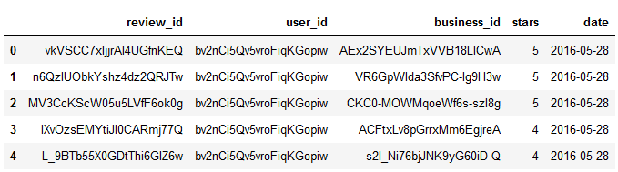

Importing Large Datasets (2)
In the last cell (from step #3 on the previous slide), change the 0 to a 1, then to a 2, to see how the length of the text column varies by row.
If we wanted, we could make a new variable that contains the length of each review. But for now, we’ll just delete the column altogether. However, instead of importing all the data and then dropping the column, we’ll use the usecols parameter in the read_csv() function to ignore the column when importing the data.
Type pd.read_csv? to inspect the usecols parameter, and notice that we’ll need a list of columns
The easiest way to get this list of columns is to type rev1.columns, then copy and paste the list of columns into our cell. While we’re at it, let’s also ignore importing the useful, funny, and cool columns:
Next, let’s slowly increment our nrows parameter, first to 1000, then 10000, etc. Each time, run this code and notice how long it takes. There will be an asterisk (*) inside the square brackets [] next to your code that indicates the code is running:
Run rev1.shape to make sure that your number of records does not equal the value you’ve put in the nrows parameter (there are 5.26 million rows in this table).
Run rev1.head() to check your work:
Practice all of the prior steps (#1 - #9) to import these columns from the yelp_user.csv file into a table called users1: ['user_id', 'name', 'review_count', 'yelping_since', 'average_stars']

Slide 5
Joins
To join data in Python, there are two functions we can use: join() or merge(). We will cover the merge() function only, as the syntax differs for join().
Run pd.merge? and review the documentation
Note that the default join type (how=) is an inner join. This means that only rows with matches in both tables will be included in the joined table. This works well for us, as we want to create a table that contains only reviews for Charlotte.
Run the following code:
Run char_rev1.shape to ensure that your new DataFrame has 237,308 rows and 12 columns
Create char_rev2 by joining char_rev1 with users1
Run char_rev2.shape to ensure that your new DataFrame has 237,308 rows and 16 columns
Run char_rev2.dtypes to review the variable types
Change the variable types for the two date variables (date and yelping_since) from object to datetime (review slide #10 Changing Variable Types of Lab #1). Make sure each variable keeps its original name (you can either overwrite the original names when changing the variable types, or, like in Lab #1, drop the original variables after changing the variable types and then rename the new variables to the original names).
Run char_rev2.head() to see a sample of the joined DataFrame. Notice the scroll bar that appears when you have a lot of columns. To view all columns at once, you can swap rows and columns using .T at the end of the DataFrame:
Right DataFrame
Left DataFrame
Key – the variable common to both DataFrames

Slide 6

String Manipulations
Review the pandas documentation Working with text data. Note that the methods available are accessed using the .str attribute, and the full list is at the end of the documentation. We will only cover a few of these.
There are two text variables that we’ll need to fix before we can move forward with an analysis. Note that there are quotes in each value for business_name and the categories variable has multiple categories.
Use the strip() function to remove all double-quotes from the business_name variable:
Look at the top values for the categories variable (you’ve done this before, in slide #12 Categorical Variables (2) of Lab #1)
Let’s look at only restaurants by using the contains() method:
Notice that it returns a list of Booleans. We can assign that code to a variable called rest_filter:
And then use that filter to subset our data into a new DataFrame:
Steps 4 and 5 can be combined into one line of code:
Notice in the output that the top two categories are both Mexican Restaurants, but they are treated as separate because the order is different

Slide 7
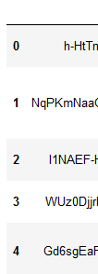

What is an Index?
Compare the output of char_rev2.head() with char_rev3.head(). Remember that char_rev2 contains all reviews for Charlotte businesses, while char_rev3 contains only the reviews for Charlotte restaurants.
Notice the numbers in bold on the left side of the DataFrame. This is called the index. Until now, we’ve ignored this, but it is very important when working with data in Python.
Usually, using an integer as the index will be fine. However, we can also use a column (or multiple columns) in our DataFrame as an index. If we’re going to do this, we need to make sure that the column we use (or combination of columns) has no duplicate values. In the Yelp data, a good candidate for a unique identifier is review_id. But let’s verify this:
Count the number of rows in char_rev3
Find the number of unique values of review_id:
Since the number of rows equals the number of unique values, we can set review_id as the index:
Look at a sample of the new DataFrame to see how review_id is now in bold.
You can no longer call char_rev3.review_id, you must use char_rev3.index
Remove the index:
View a sample of the dataset, and notice how the integers have been reset (they no longer skip numbers).
char_rev2
char_rev3
Rows 1 and 2 are not included in char_rev3 because these businesses are not restaurants.

Slide 8

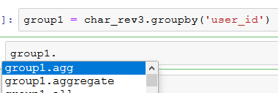
Aggregation (1)
We’ve already done aggregation using the value_counts() function. Let’s review this and put the output in a DataFrame:
Run this code to quickly see the number of times each business_name appears in the DataFrame:
Notice the output looks like data, but not the normal output from a DataFrame:
We can easily make it into a pandas DataFrame by putting the code inside of the pd.DataFrame() function:
Note how the DataFrame has business_name as an index, with one column that contains the count.
Assign this code to a new DataFrame called review_count and reset the index
For more complex aggregation, we’ll use the groupby() function. This function returns a “GroupBy object”:
Run this code:
To return a DataFrame with metrics (like we would with a pivot table in Excel), we’ll need more code.
Assign the code in the previous step to a variable called group1, and in the following cell, type group1. and press tab:
Now, we can see all of the functions we can use. You’ll notice there are sum, mean, count, and others, but using these applies to all numeric variables. Run group1.mean() to see the output

Slide 9
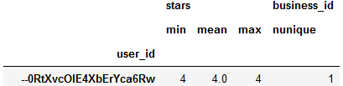
Aggregation (2)
Our main tool for aggregating in Python will be the agg() function. This will allow us to specify all of the columns we want in our resulting DataFrame, and which functions to apply to each.
Remember that we have already chosen which categorical variable we want to aggregate by (in step #7 of the previous slide).
To get an average of the stars variable for every user, run the following:
One thing to point out here: inside the parentheses () for the agg() function is a set of curly braces {}, which indicates a “dict” structure (dictionary). This is a common python data structure that you’ll see more of in the future, but right now, all we need to know is that it contains pairs of things separated by commas. In the code above, we only have one pair, so there’s no comma needed. The name of the variable goes first, then a colon, then the function we want to apply to the variable.
Run the following code to add the number of unique businesses that each user reviewed:
Assign the code above to a new DataFrame called users_agg, and view a sample to make sure it’s right
If you want to apply multiple functions to one variable, you can specify them in a list. Run this:
Assign that code to a new DataFrame called users_agg2 and view a sample
Note the multiple levels of column headers. This is called a “MultiIndex.” This can get confusing, so we want to get back to a standard data structure. Run this code:
This reassigns our column names using a for loop.

Slide 10
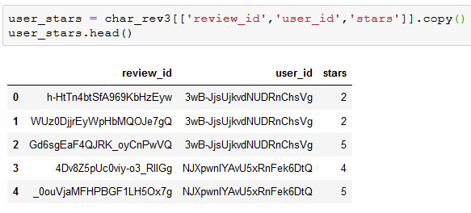
Conditionals (1)
There are a few ways to create a new variable with a conditional (if/then/else) formula. For new variables with only two possible values, the best way is to use the lambda() function.
Run the following code to create a new DataFrame with 3 columns from the char_rev3 DataFrame:
We want to build a new variable called rating on the user_stars DataFrame that contains two values: ‘Good’ if stars is greater than or equal to 3, and ‘Bad’ if the review is a 1 or 2.
Run the following code:
This is called a lambda function, and will run the logic that we define for every value that passes through it. Note that x is called a “local variable,” which means it will only be used within the function (that is, you can’t refer to x in another line of code and expect the program to know what you’re referring to).
Create the new variable by calling the lambda function using the apply() function:
Note that steps 2 and 3 can be combined (and you’ll most likely see other people write lambda functions in this way):
Note that we can have multiple lines of code in each cell of our notebook. So far, we’ve only used one line at a time to make it easier to troubleshoot. But as you get better, you can combine multiple lines into one cell, or merge cells (on the top menu, click Edit -> Merge Cell Above/Below).

Slide 11
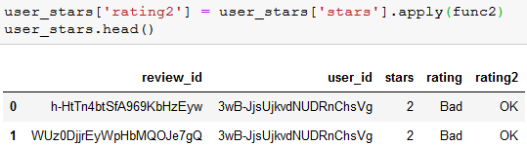
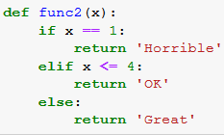
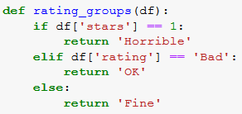
Conditionals (2)
If you want to create a variable with more than two values, the best way is to create a user-defined function.
Run the following code:
Run the following code to create the new variable:
If we want to use multiple variables in our condition, then we can create a function that will be applied at the DataFrame level.
Run the following code to create a function that takes a DataFrame as a parameter (we use df instead of x so we remember:
Run the following code to create the rating3 variable:
(axis=1 tells it to apply the function on each row)
The blue text func2 is what our function is called. You can name it anything.
x is the parameter that our function will use, similar to the local variable in the lambda function on the previous slide. You can have multiple parameters within the parentheses separated by commas
The def keyword tells Python that this is a function (note the green text denotes Python keywords)
Note that after you type the colon : and press enter, Python automatically indents the next line by 4 spaces. This spacing is how Python knows the line is “within” the previous line of code.
The return keyword denotes the output of the function

Slide 12

Crosstabs
Let’s finish up the data transformations in this lab with one final step. Let’s remove any reviews by users with only a few reviews, or by any users who only post good or bad reviews.
Run the following code:
Note that we can aggregate by multiple variables by putting the variable names in a list.
Count the number of reviews for each user/rating combo. Reset the index on the same line of code:
Use the pivot_table() function to build a crosstab. Note there is also a crosstab() function in pandas
Run the following code to subset the users_agg2 table (we created this table in step #5 of slide #9 Aggregation (2)):
Join user_stars3 onto users_agg3, naming the resulting output users_agg4. You may want to review slide #5 Joins if you need to refresh your memory.
Create a new variable to find the percent of reviews each user gave with 4 or 5 stars.
Filter the users_agg4 DataFrame to remove any users with a good_pct less than 10% or greater than 90%
Reset the index for users_agg4
To filter the char_rev3 DataFrame to only include reviews by users in the users_agg4 DataFrame, you can specify only one column in the merge code:
Output the DataFrame to the path we defined on slide #2:

